Slide 1
Exploiting Instruction Level Parallelism with Software Approaches
Compiler Techniques for Exposing ILP

Slide 2
How compilers can help processors ?

Slide 3
Limited ILP
Chain of dependencies
ADD R1, R2, R3
ADD R4, R1, R5
ADD R7, R4, R8
ADD R10, R7, R3
ADD R11, R10, R12

Slide 4
Limited Window
Independent instructions far apart
Ideal processor
No problem
Real processor
Some instructions can never be seen
Runs out of ROB space
Runs out of reservation stations
Example:

Slide 5
Tree Height Reduction
R8=R2+R3+R4+R5
R8=(R2+R3)+(R4+R5)
ADD R8, R2, R3
ADD R8, R8, R4
ADD R8, R8, R5
ADD R8, R2, R3
ADD R7, R4, R5
ADD R8, R8, R7

Slide 6
Tree Height Reduction
R8=R2+R3+R4+R5
R8=(R2+R3)+(R4+R5)
ADD R8, R2, R3
ADD R8, R8, R4
ADD R8, R8, R5
Independent instructions can execute in parallel on a processor that can do at least 2 instruction per cycles
ADD R8, R2, R3
ADD R7, R4, R5
ADD R8, R8, R7

Slide 7
Tree Height Reduction
Associativity
Not all operations are associative
We can only apply tree height reduction if the final result is the same as if we did things in proper order

Slide 8
Example
ADD R10, R1, R2
SUB R10, R10, R3
ADD R10, R10, R4
SUB R10, R10, R5
ADD R10, R10, R6
SUB R10, R10, R7

Slide 9
Example
What we are trying to compute (Rewrite the expression)
R1+R2-R3+R4-R5+R6-R7
Rewrite the expression
R1+R2
R4+R6
(R1+R2)+(R4+R6)
R3+R5
(R3+R5)+R7
((R1+R2) +(R4+R6))-((R3+R5)+R7)

Slide 10
Example
ILP
ILP
ADD R10, R1, R2 | ADD R10, R1, R2
SUB R10, R10, R3 | ADD R11, R4, R6
ADD R10, R10, R4 | ADD R10, R10, R11
SUB R10, R10, R5 | ADD R11, R3, R5
ADD R10, R10, R6 | ADD R11, R11, R7
SUB R10, R10, R7 | SUB R10, R10, R11

Slide 11
Instruction Scheduling
Techniques that make independent instructions easily available to the processor
Ideal Processor
Able to look at infinite number of instructions
Real Processor
Able to see only a limited number of instructions
Take help of the compiler

Slide 12
Instruction Scheduling
Instruction Scheduling
Independent instructions
Dynamic Scheduling
Tomosula’s algorithm : Hardware based approach
Static Scheduling
Compiler based approach

Slide 13
Example
LW R2, 0(R1)
ADD R2, R2, R0
SW R2, 0(R1)
ADDI R1, R1,4
BNE R1, R3, loop
A very simple Processor only looks at the next instruction (single issue), in-order, no reservation stations
Load 2 cycles
Add takes 3 cycles

Slide 14
Example
LW R2, 0(R1) | LW R2, 0(R1)
ADD R2, R2, R0 | 1 stall
SW R2, 0(R1) | ADD R2, R2, R0
ADDI R1, R1,4 | 2 stall
BNE R1, R3, loop | SW R2, 0(R1)
 | ADDI R1, R1,4
 | 2 stall
 | BNE R1, R3, loop

Slide 15
Example
LW R2, 0(R1) | LW R2, 0(R1)
1 stall | ADDI R1, R1, 4
ADD R2, R2, R0 | ADD R2, R2, R0
2 stall | 2 stall
SW R2, 0(R1) | SW R2, 0(R1)
ADDI R1, R1,4 | ADDI R1, R1,4
2 stall | 2 stall
BNE R1, R3, loop | BNE R1, R3, loop

Slide 16
Example
LW R2, 0(R1) | LW R2, 0(R1)
1 stall | ADDI R1, R1, 4
ADD R2, R2, R0 | ADD R2, R2, R0
2 stall | 2 stall
SW R2, 0(R1) | SW R2, 0(R1)
ADDI R1, R1,4 | ADDI R1, R1,4
2 stall | 2 stall
BNE R1, R3, loop | BNE R1, R3, loop

Slide 17
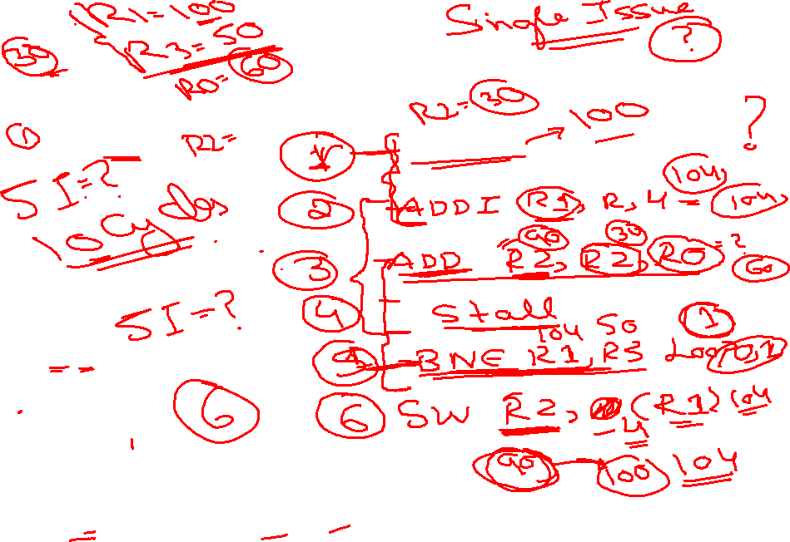
Example
LW R2, 0(R1) | LW R2, 0(R1)
1 stall
ADD R2, R2, R0
2 stall
SW R2, 0(R1)
ADDI R1, R1,4
2 stall
BNE R1, R3, loop

Slide 18
Instruction Scheduling
Find Independent Instructions that can be used to replace the stalls

Slide 19
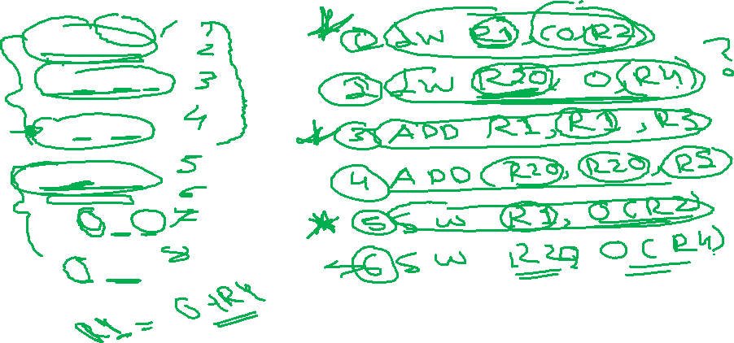
Instruction Scheduling
LW R1, 0(R2)
ADD R1, R1, R3
SW R1, 0(R2)
LW R1, 0(R4)
ADD R1, R1, R5
SW R1, 0(R4)
Load 2 cycles
Add takes 1cycle
Store 1 Cycle
-One Instruction per cycle
-In order

Slide 20
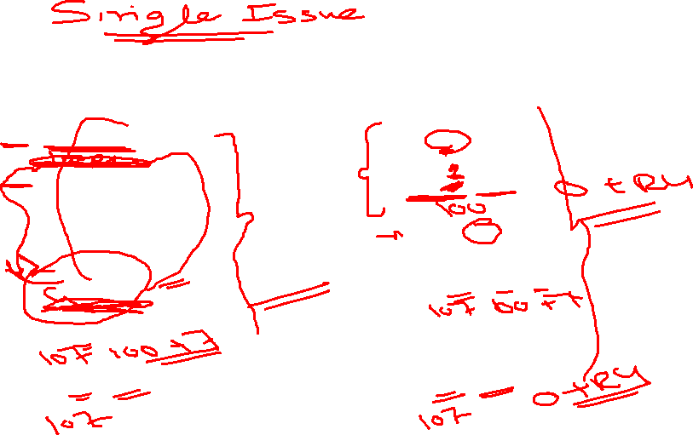
Instruction Scheduling
Cycles
Cycles
LW R1, 0(R2) | LW R1, 0(R2)
ADD R1, R1, R3 | LW R10, 0(R4)
SW R1, 0(R2) | ADD R1, R1, R3
LW R1, 0(R4) | ADD R10, R10, R5
ADD R1, R1, R5 | SW R1, 0(R2)
SW R1, 0(R4) | SW R10, 0(R4)
Load 2 cycles
Add takes 1cycle
Store 1 Cycle
-One Instruction per cycle
-In order

Slide 21
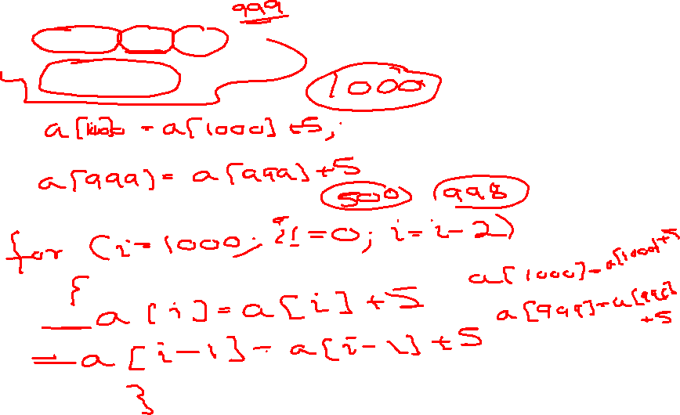
Loop Unrolling
For (i=1000; i !=0; i--)
a[i]=a[i]+5;

Slide 22
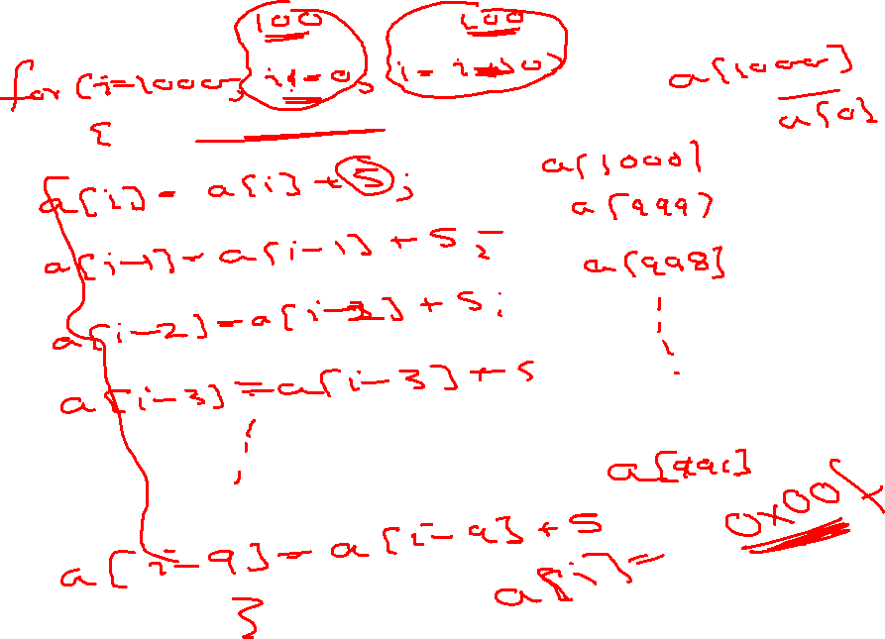

Slide 24
Loop Unrolling
By making each iteration of the new loop do more than one iteration of the old loop
Each iteration of the new loop would do the work it should be doing plus the work of the next iteration

Slide 25
Loop Unrolling
For (i=1000; i !=0; i--)
a[i]=a[i]+5;
a[i]=a[i]+5;

Slide 26
Loop Unrolling
For (i=1000; i !=0; i=i-2)
a[i]=a[i]+5;
a[i-1]=a[i-1]+5;

Slide 27
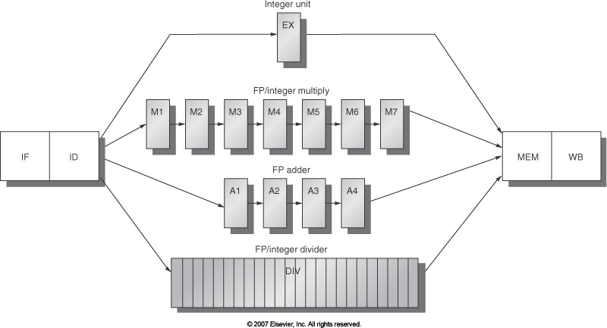
Super Scalar Processor

Slide 28
Assumptions
Load: 2-cycles (1 cycle stall for consumer)
FP ALU: 4-cycles (3 cycle stall for consumer; 2 cycle stall
if the consumer is a store)
One branch delay slot
Int ALU: 1-cycle (no stall for consumer, 1 cycle stall if the
consumer is a branch)
LD -> any : 1 stall
FPALU -> any: 3 stalls
FPALU -> ST : 2 stalls
IntALU -> BR : 1 stall

Slide 29
Loop Example
for (i=1000; i>0; i--)
x[i] = x[i] + s;
Source code
Loop: L.D F0, 0(R1) ; F0 = array element
ADD.D F4, F0, F2 ; add scalar
S.D F4, 0(R1) ; store result
DADDUI R1, R1,# -8 ; decrement address pointer
BNE R1, R2, Loop ; branch if R1 != R2
NOP
Assembly code

Slide 30
LD -> any : 1 stall
FPALU -> any: 3 stalls
FPALU -> ST : 2 stalls
IntALU -> BR : 1 stall
Loop Example
for (i=1000; i>0; i--)
x[i] = x[i] + s;
Source code
Loop: L.D F0, 0(R1) ; F0 = array element
ADD.D F4, F0, F2 ; add scalar
S.D F4, 0(R1) ; store result
DADDUI R1, R1,# -8 ; decrement address pointer
BNE R1, R2, Loop ; branch if R1 != R2
NOP
Assembly code
Loop: L.D F0, 0(R1) ; F0 = array element
stall
ADD.D F4, F0, F2 ; add scalar
stall
stall
S.D F4, 0(R1) ; store result
DADDUI R1, R1,# -8 ; decrement address pointer
stall
BNE R1, R2, Loop ; branch if R1 != R2
stall
10-cycle
schedule

Slide 31
LD -> any : 1 stall
FPALU -> any: 3 stalls
FPALU -> ST : 2 stalls
IntALU -> BR : 1 stall
Smart Schedule
Loop: L.D F0, 0(R1)
stall
ADD.D F4, F0, F2
stall
stall
S.D F4, 0(R1)
DADDUI R1, R1,# -8
stall
BNE R1, R2, Loop
stall
Loop: L.D F0, 0(R1)
DADDUI R1, R1,# -8
ADD.D F4, F0, F2
stall
BNE R1, R2, Loop
S.D F4, 8(R1)
By re-ordering instructions, it takes 6 cycles per iteration instead of 10
We were able to violate an anti-dependence easily because an
immediate was involved
Loop overhead (instrs that do book-keeping for the loop): 2
Actual work (the ld, add.d, and s.d): 3 instrs
Can we somehow get execution time to be 3 cycles per iteration?

Slide 32
Loop Unrolling
Loop: L.D F0, 0(R1)
ADD.D F4, F0, F2
S.D F4, 0(R1)
L.D F6, -8(R1)
ADD.D F8, F6, F2
S.D F8, -8(R1)
L.D F10,-16(R1)
ADD.D F12, F10, F2
S.D F12, -16(R1)
L.D F14, -24(R1)
ADD.D F16, F14, F2
S.D F16, -24(R1)
DADDUI R1, R1, #-32
BNE R1,R2, Loop
Loop overhead: 2 instrs; Work: 12 instrs
How long will the above schedule take to complete?

Slide 33
Scheduled and Unrolled Loop
Loop: L.D F0, 0(R1)
L.D F6, -8(R1)
L.D F10,-16(R1)
L.D F14, -24(R1)
ADD.D F4, F0, F2
ADD.D F8, F6, F2
ADD.D F12, F10, F2
ADD.D F16, F14, F2
S.D F4, 0(R1)
S.D F8, -8(R1)
DADDUI R1, R1, # -32
S.D F12, 16(R1)
BNE R1,R2, Loop
S.D F16, 8(R1)
LD -> any : 1 stall
FPALU -> any: 3 stalls
FPALU -> ST : 2 stalls
IntALU -> BR : 1 stall
Execution time: 14 cycles or 3.5 cycles per original iteration

Slide 34
Superscalar Pipelines
Integer pipeline FP pipeline
Loop: L.D F0,0(R1)
L.D F6,-8(R1)
L.D F10,-16(R1) ADD.D F4,F0,F2
L.D F14,-24(R1) ADD.D F8,F6,F2
L.D F18,-32(R1) ADD.D F12,F10,F2
S.D F4,0(R1) ADD.D F16,F14,F2
S.D F8,-8(R1) ADD.D F20,F18,F2
S.D F12,-16(R1)
DADDUI R1,R1,# -40
S.D F16,16(R1)
BNE R1,R2,Loop
S.D F20,8(R1)
Need unroll by degree 5 to eliminate stalls
The compiler may specify instructions that can be issued as one packet
The compiler may specify a fixed number of instructions in each packet:
Very Large Instruction Word (VLIW)

Slide 35
Loop Unrolling
In Order: 1 Instruction per Cycle
LD -> any : 2 stall
ADD/ADDI -> any: 1 stalls
Loop: LW R1, 0(R2)
After scheduling the loop (w/o unrolling)
________________cycles/1000 iterations
After unrolling once and scheduling
________________cycles/1000 iterations
Loop: LW R1, 0(R2)
ADD R3, R3, R1
ADDI R2, R2, 4
BNE R2, R4, Loop

Slide 36
Loop Unrolling
It reduces the overall number of instructions we have to execute
It also can reduce the IPC/CPI in addition to reducing the number of instructions

Slide 37
Loop Unrolling
Increases program size
Requires more registers
To unroll an n-iteration loop by degree k, we will need (n/k)
iterations of the larger loop, followed by (n mod k) iterations
of the original loop

Slide 38
Function Call In lining
Optimization
Avoid the overhead of calling the function and returning from it
Prepare function parameters
Call function
Return from the function
Simply take the work of the parameter and put it there

Slide 39
Function Call In lining
Instructions
Prepare function parameters
Call function
Other instructions
Function Rd, Rs1, Rs2
Return

Slide 40
Function Call In lining
Instructions
Add Rd1, Rs1, Rs2
Other instructions
Eliminates call/return overheads
Helps in Scheduling (imp)

Slide 41
Function Call Inline (Disadvantages)
Code Bloat
For large codes

Slide 42
Example (Function In lining) scheduling and over head
LW A0, 0(R1)
CALL ADDSQUARE
 | ADDSQUARE:
 | MUL A0, A0, A0
 | ADD RV, A0, A1
 | RETURN
SW RV, 0(R2)
LW 2 CYCLES
CALL 2 CYCLES
RETURN 2 CYCLES
SW/ADD 1 CYCLE
MUL 3 CYCLES

Slide 43
Example (Function In lining) scheduling and over head
LW A0, 0(R1)
MUL A0, A0, A0
ADD RV, A0, A1
SW RV, 0(R2)
LW 2 CYCLES
CALL 2 CYCLES
RETURN 2 CYCLES
SW/ADD 1 CYCLE
MUL 3 CYCLES

Slide 45
Software Pipeline?!
L.D
ADD.D
S.D
DADDUI
BNE
L.D
ADD.D
S.D
DADDUI
BNE
L.D
ADD.D
S.D
DADDUI
BNE
L.D
ADD.D
S.D
DADDUI
BNE
…
Loop: L.D F0, 0(R1)
ADD.D F4, F0, F2
S.D F4, 0(R1)
DADDUI R1, R1,# -8
BNE R1, R2, Loop
L.D
ADD.D
DADDUI
BNE
…
L.D
ADD.D
DADDUI
BNE

Slide 46
Software Pipeline?!
Store for Iter. 1, Add for Iter. 4 and Load for Iter. 6
L.D
ADD.D
S.D
DADDUI
BNE
L.D
ADD.D
S.D
DADDUI
BNE
L.D
ADD.D
S.D
DADDUI
BNE
L.D
ADD.D
S.D
DADDUI
BNE
…
Loop: L.D F0, 0(R1)
ADD.D F4, F0, F2
S.D F4, 0(R1)
DADDUI R1, R1,# -8
BNE R1, R2, Loop
L.D
ADD.D
DADDUI
BNE
…
L.D
ADD.D
DADDUI
BNE

Slide 47
Software Pipeline
L.D
ADD.D
S.D
Original iter 1
L.D
ADD.D
S.D
Original iter 2
L.D
ADD.D
S.D
Original iter 3
L.D
ADD.D
S.D
Original iter 4
New iter 1
L.D
ADD.D
S.D
L.D
ADD.D
S.D
New iter 2
L.D
ADD.D
New iter 3
L.D
New iter 4

Slide 48
Software Pipelining
Loop: L.D F0, 0(R1)
ADD.D F4, F0, F2
S.D F4, 0(R1)
DADDUI R1, R1,# -8
BNE R1, R2, Loop
Loop: S.D F4, 16(R1)
ADD.D F4, F0, F2
L.D F0, 0(R1)
DADDUI R1, R1,# -8
BNE R1, R2, Loop
Advantages: achieves nearly the same effect as loop unrolling, but
without the code expansion – an unrolled loop may have inefficiencies
at the start and end of each iteration, while a sw-pipelined loop is
almost always in steady state – a sw-pipelined loop can also be unrolled
to reduce loop overhead
Disadvantages: does not reduce loop overhead, may require more
registers

